Slide 1
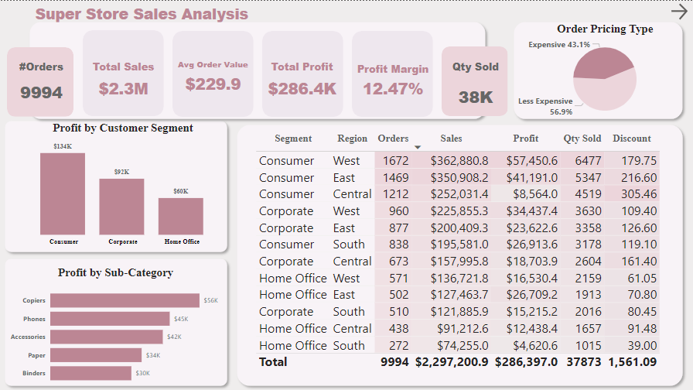

Slide 2
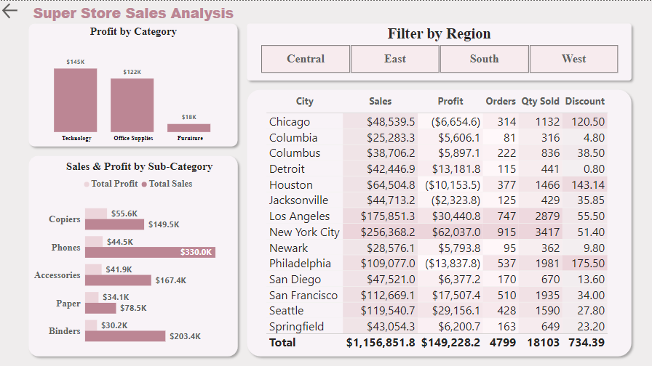

Slide 3
Super Store Sales analysis
An Internship Project
@InnoByte Services

Slide 4
Super Store Sales Analysis
Key Skills Practised:
Excel
Power BI
DAX(Data Analysis Expression)
KPIs Calculation
Visualizations(Charts, Filters)
@InnoByte Services

Slide 5
Super Store Sales Analysis
Project Purpose:
Analyze retail sales data to derive insights into customer behaviour, popular products, and sales trends.
@InnoByte Services

Slide 6


Super Store Sales Analysis
About Data:
Raw dataset contains 13 columns and 9994 rows.
@InnoByte Services

Slide 7
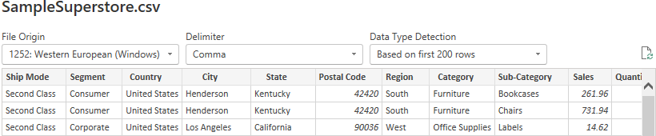
Super Store Sales Analysis
Approach Used:
Loaded data into Power BI
@InnoByte Services

Slide 8
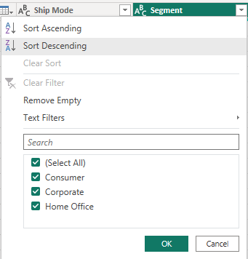
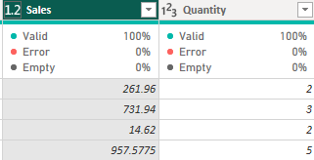
Super Store Sales Analysis
Approach Used:
Data exploration
@InnoByte Services

Slide 9
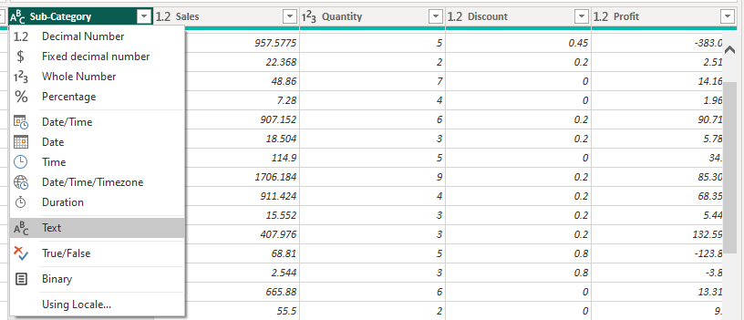
Super Store Sales Analysis
Approach Used:
Checked Data Types
@InnoByte Services

Slide 10
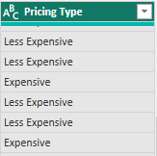
Super Store Sales Analysis
Approach Used:
Added conditional column, ‘Pricing Type’
@InnoByte Services

Slide 11
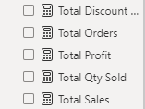
Super Store Sales Analysis
Descriptive Statistics:
Calculated Business KPIs
@InnoByte Services

Slide 12


Super Store Sales Analysis
Descriptive Statistics:
Calculated Business KPIs
@InnoByte Services

Slide 13
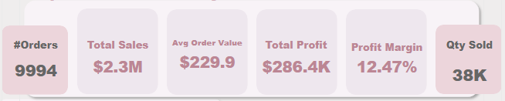
Super Store Sales Analysis
Descriptive Statistics:
Visualized KPIs using card visuals
@InnoByte Services

Slide 14
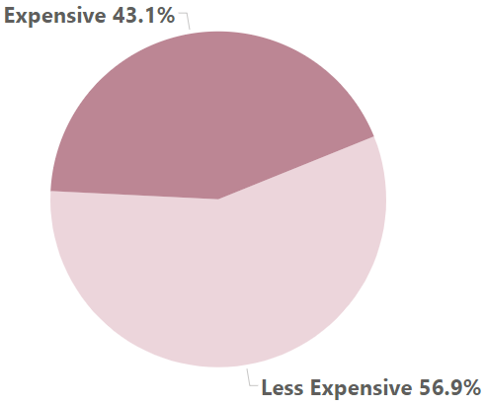
Super Store Sales Analysis
Order Pricing Types:
Visualized order pricing types i.e. Expensive and Less Expensive based on sales
@InnoByte Services

Slide 15
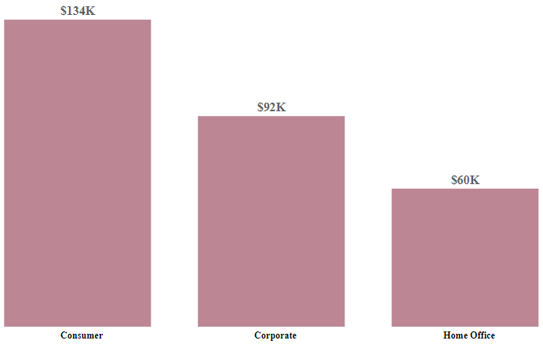
Super Store Sales Analysis
Customer Segmentation:
Profit by Customer Segment
@InnoByte Services

Slide 16
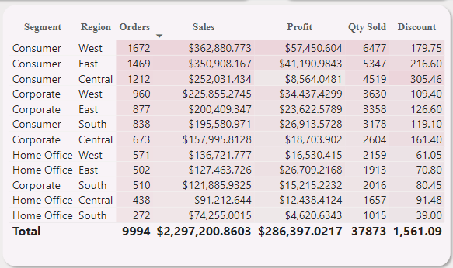
Super Store Sales Analysis
Customer Segmentation:
Customer Segmentation analysis by orders, sales, profit, quantity sold and discount.
@InnoByte Services

Slide 17
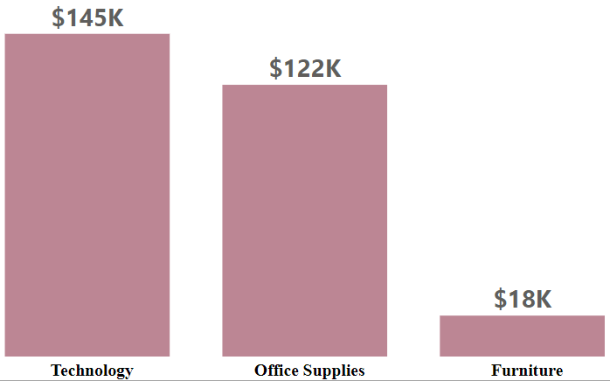
Super Store Sales Analysis
Category Segmentation:
Profit by Category shown through column chart.
@InnoByte Services

Slide 18
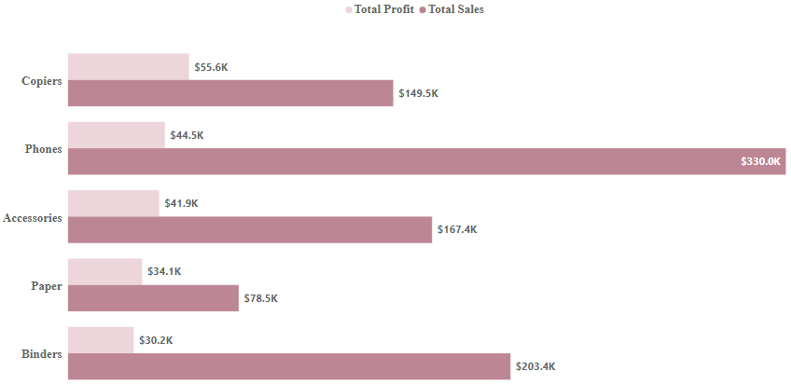
Super Store Sales Analysis
Category Segmentation:
Sales & Profit by top-5 Sub-Categories
@InnoByte Services

Slide 19

Super Store Sales Analysis
Region Segmentation:
Filter trends and relationships based on specific region.
@InnoByte Services

Slide 20
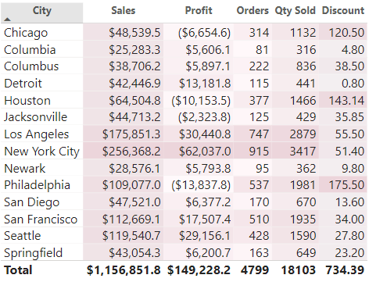
Super Store Sales Analysis
Region Segmentation:
City wise trends.
@InnoByte Services

Slide 21
Super Store Sales Analysis
Dashboard-1:
@InnoByte Services

Slide 22
Super Store Sales Analysis
Dashboard-2:
@InnoByte Services

Slide 23
Super Store Sales Analysis
Insights:
Customer segment ‘Consumer’ generated 50.56% of the total sales.
Product category ‘Technology’ brought most sales of 36.40% of the total sales.
Top-5 Sub-Categories made 72% of the total Profit.
33.7% of the total sales made by top-5 cities.
@InnoByte Services

Slide 24
Super Store Sales Analysis
Recommendations:
Try to improve sales of consumer products by giving discounts, packages and making marketing campaigns.
Improve ‘Technology’ products as it brings most sales of all categories.
Run marketing campaigns in top most cities to get more sales.
@InnoByte Services

Slide 25
Thank You
DHARMINDAR RAM
Data Analyst | Business Intelligence Developer
Linkedin Portfolio Github E-mail

